Slide 1
Brandwonden Project
The wound lies in bridges
When the grave lengthens,
When patience stretches
The wound, a gesture, is passing.
-Adonis

Slide 2
What is the link between the innate immune system model and the wound healing process?
No other papers have modeled this relationship.
Several validated models simulate one/two phases of wound healing.
Main difference with cuteanous wounds is coagulation, loss of the skin appendages and re-epithelialization, which can only occur from the edges of the wound.
These models only consider the immune system indirectly, while usually explicitly referring to the specific cytokines that activated macrophages release such as TGF-β, TNF-α and interleukins.
Using the same cell populations as the immune system model,
e.g. pro/anti inflammatory cytokines, activated/resting leukocytes, etc.
Essentially, once we have connected the HIIS model to the specific cytokines involved in almost all aspects of the healing process (TGFB,FGF,PDGF, VEGF, TNFa, IL), much of the legwork has been done by these papers.

Slide 3
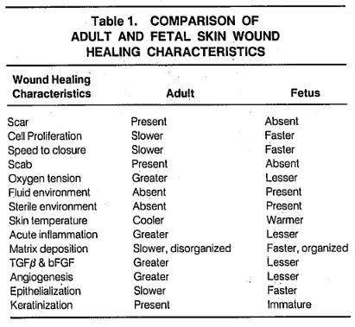
Anti-TGF-β Hypothesis
We (and others) hypothesise that anti-TGF-β therapies later in the healing process may lead to less scarring but slower healing.
Red deer antler (traditional Chinese medicine) ointment found to modulate TGF-β levels and improve cutaneous wound healing outcomes in full-thickness rat models (Gu et al., 2008)
Scarring in adults associated with excessive action of TGF-β
Scarless fetal wounds are relatively deficient in the inflammatory cytokine TGFB (also sparse inflammatory response (reduced macrophage and monocyte infiltrates, absence of endogenous immunoglobulins at the wound site, reduced angiogenesis, and altered levels of peptide growth factors) (Adzick and Lorenz, 1994)
It appears that adult wounds may be optimised for speed of healing under adverse conditions, resulting in excessive inflammatory infiltrate and cytokine profile (Adzick and Lorenz, 1994)
Modulation of AP (through interaction with macrophages) may in fact work in this capacity. (“only” speculation until we validate model).

Slide 4
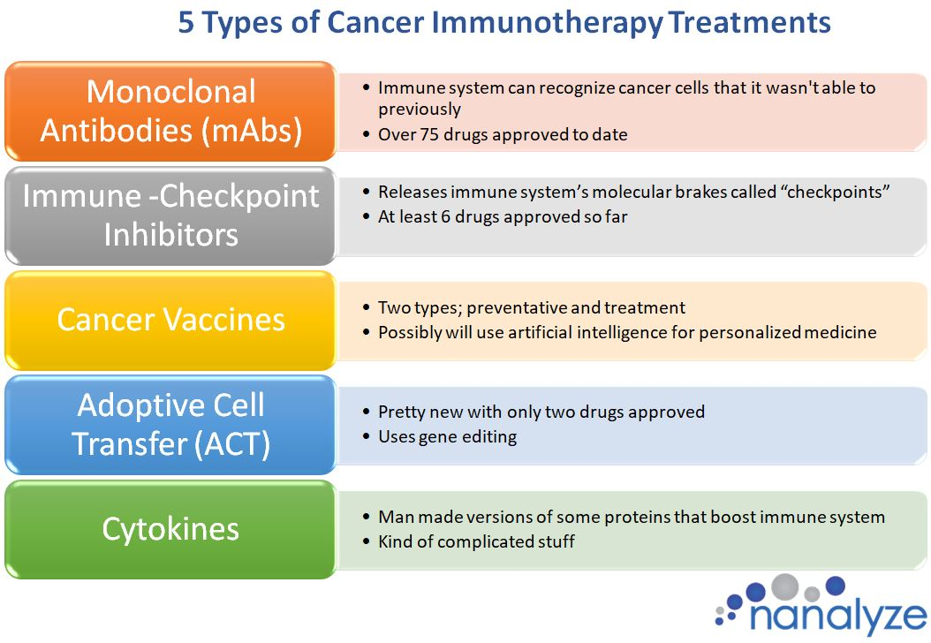
Immunotherapy
Common in early 20th century, until the efficacy of penicillin made it (somewhat) obsolete.
Anti-biotic resistance and rejection of reductionist approach has lead to new found appreciation for the approach.
Especially in cancer treatment.

Slide 5
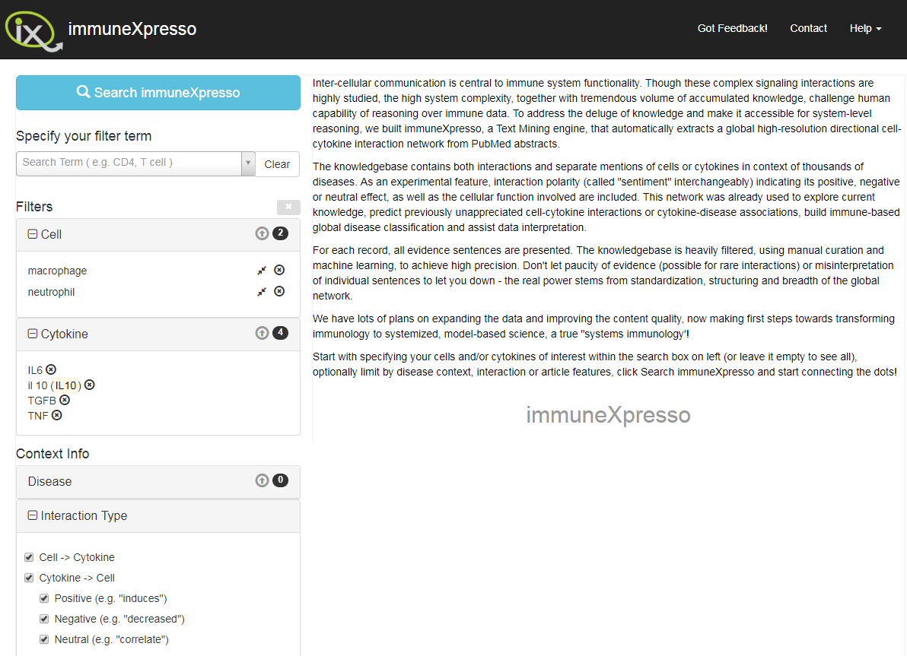
ImmuneXpresso [Kveler et al., 2018]
Prior to finding this paper, we had been manually collating all cell-cytokine interactions from literature.
We can initially train the network on this interaction data but would really like burn wound specific biomarker information over the phases of healing we decide to model.

Slide 6
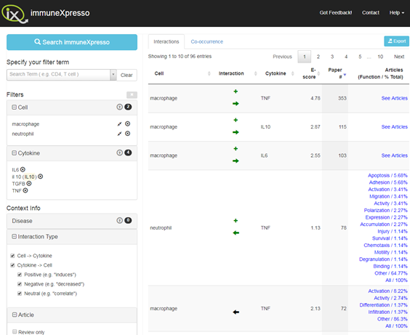
ImmuneXpresso Search Results

Slide 7
Causes of Excessive Scarring
Inflammation phase lasting too long (Tepole,
Macrophages not changing to anti-inflammatory phenotype
Fibroblast overshoot causing collagen dump, can be seen in 1D
Failure to remove inflammatory cells causes pathogenesis of non-healing wounds – but clearing/scrapping wounds may fix this anyway

Slide 8
Proposed Model Structure
HIIS model connected to a generalised ECM by deep learning algorithm.
ECM acts as an interface to ABM models. HIIS can be modulated by AP, while the ECM can be modulated by topical application.
ABM models can then be swapped out while the ECM composition remains.

Slide 9
Options for Non-Machine Learning ECM to HIIS
Simply use a network or Partial DE based on cell-cytokine interactions found in literature
Use existing data to translate between the broader categories of the HIIS and the specific ECM composition used by ABM models.
Some combination:
Layers between blood composition and HIIS. Then different network connecting these cytokines to the ECM.
Train/establish an interscopic (non-hierachical) network based on cell-cytokine literature and later tuned/refined by data collected at burn centre

Slide 10
Options for ML HIIS to ECM
Create a generalised ECM-HIIS deep learning network trained on available date (including non-burn wounds (with less weighting)).
Include a mid-level layer for blood (system) cytokine levels.
Hypergraph Learning – In our case, modelling pairwise relationships will lead to a loss in information. In a hypergraph an edge can connect more than two vertices, i.e. an edge is a subset of vertices.

Slide 11
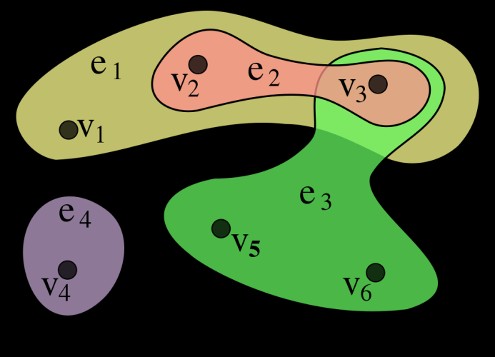
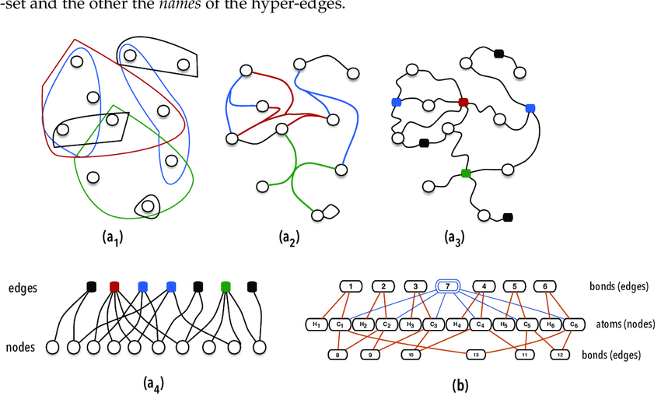
Hypergraphs
A hypergraph-based learning algorithm for classifying gene expression and arrayCGH data with prior knowledge (Tian et al., 2009). - Presents a hypergraph semi-supervised learning that introduces extra hypergraph structural cost to restrict the learning results.
Scalable Hypergraph Learning and Processing (Huang et al., 2015) - Distributed framework for large scale hypergraphs in Apache Spark.

Slide 12
Options for ABM models connected to neural network
TU Delft papers – Fred V
Tepole papers
Create our own hybrid or novel model
Cellular Automata angiogenesis?
Inflammatory stage for set up of proliferation

